Slide 1
WASC Guidelines
for
Schools and Visiting Committee Chairs
Virtual Full Visits
Fall 2020

Slide 2
International
Serving almost 5,200 schools worldwide
35 Commissioners
20 Partner Associations

Slide 4
How well are all students learning and achieving?

Slide 5
Accreditation Cycle of Quality

Slide 6
Let’s Have a Conversation….
What are the expectations for a school and the visiting committee chair for a virtual full visit?
Notes:
Putting this in the very beginning so as to point out how we can address COVID-19. Minimal as of Sept. 2020.

Slide 7
Virtual Visit: School Expectations
Process and Result as rigorous and thorough as an on-site visit
Focus on continuous school improvement and the progress related to high quality learning and well-being for all students
Video, audio and connectivity quality must be sufficient to allow good communication—both recorded and live

Slide 9
The Big Picture
Ultimate Goal:
A Quality Action Plan
owned by
All Stakeholders

Slide 10
Road to the Action Plan

Slide 11
To WASC and to the Visiting Committee
6 weeks before the visit!

Slide 12
How does the school organize and make this a quality virtual visit?
How does the Visiting Committee chair and members get to know the school?
The Visit

Slide 13
Preparing for the Visit
Hosting
Students
Technology
Evidence
Schedule
Remembering
Planning
Staff
Notes:
Remember what we learned and reflect on how those insights might make things different for us (teachers, students, families, staff) in the future.
Plus, make sure all’s in order for the visit.
Watch and listen to chair and VC member training webinars!

Slide 14
Virtual Visit: School Expectations
School not required to update written self-study report
However, school will be able to share what has been done since the report was completed with supporting information, including impact of online learning for the students and other issues related to the COVID-19 Pandemic.
Ensure the self-study and supporting evidence available prior to visit for visiting committee (VC).
VC chair may request additional information related to student wellness and safety standards, such as the school’s Safety Plan.

Slide 15
Virtual Visit: School Expectations
WASC visit occurring-Inform all stakeholders
Inform VC chair about parameters, i.e., any contractual requirements
Student meetings include a staff member and two visiting committee members

Slide 16
Virtual Visit: Size of Visiting Committee
Normal Guidelines for Size of the Visiting Committee but may be adjusted:
--Enrollment 6-249 3 members
--Enrollment 250-899 4 members
--Enrollment 900-1499 5 members
--Enrollment 1500-2499 6 members
--Enrollment 2500 or more 7 members

Slide 17
Virtual Visit: The Schedule
Required meetings and observations will still occur:
Chair previsit work with school and visiting committee members
Chair and school reference the suggested in-person schedule but will adapt based on school context, i.e., some meetings may occur prior to visit dates or be combined
Important to know the names of all meeting attendees

Slide 18
Virtual Visit: The Schedule
WASC Full Visit Expectations
Daily meeting between the principal/school leader and VC chair
Daily meeting between the Leadership Team and the Visiting Committee
Meetings with all Focus Groups—all members (may have to be two meetings)
Separate meetings with students, parents, teachers, counselors, support staff, governing authority (e.g., district/complex area) and other meetings as needed

Slide 19
Virtual Visit: The VC Report
Visiting Committee Chair leaves final list of Schoolwide Strengths and Growth Areas for Continuous Improvement (Critical Areas for Follow-up) with school leadership
Visiting Committee Chair sends final report within 10 working days of visit to school

Slide 20
Virtual Visit: Important Technological Requirements
The school will need to ensure the following technological capabilities:
online conferencing facilities to allow small groups to participate in meetings (e.g., Zoom, Google Meetings, WebEx, Microsoft Teams, Skype or similar); individual stations (laptops) tend to work better than large groups in a room;
reliable Internet access to support the above;
video recording, camera. Tablet/iPAD/SMARTphone devices for recording devices to record video and images of the school prior to the virtual team evaluation visit; and

Slide 21
Virtual Visit: Important Technological Requirements (cont.)
The school will need to ensure the following technological capabilities:
video recording devices and the wireless support necessary to stream live video of the school in action if it is in session during the virtual team evaluation visit or the ability to observe virtual classes in session.
NOTE: The visiting committee chair/members will conduct a test of the technological requirements with the school before the virtual evaluation visit.

Slide 22
Virtual Visit: Suggested Videos for Visiting Committee Prior to Visit
General Introduction to School and Learning Environment
Health and Safety, Child Protection and Safeguarding—All building and outdoor areas, including additional sites
Learning Videos

Slide 23
Virtual Visit: Suggested Videos
Health and Safety, Child Protection and Safeguarding
Science Laboratories, including preparation rooms and safety equipment
Art/music/drama facilities, including practice rooms
Sports facilities, including playing surfaces and changing areas
Emergency and Security features
Appropriate child protection and safeguarding features of all the facilities
Social-emotional and career counseling rooms with regard to child protection and safeguarding
Other areas based on school context

Slide 24
Virtual Visit: Suggested Videos
Learning Videos
Sampling of recorded lessons that include…
Range of different grade levels, curricular areas, specialist learning areas and facilities

Slide 25
Virtual Visit: Observations of School in Action during the Accreditation Visit
School provide Master Schedule (virtual and/or on-site)
School and VC chair establish a schedule for VC member to observe live teaching and learning—ensuring a quality stratified sample
VC chair and school select a stratified group of classes based on grade levels, school programs, subject areas, types of course, student groups and other important issues (Suggested time frame is 15-20 minutes but can vary with type of class and school)
School and VC chair work together on best platform and video device and how it is positioned

Slide 26
Chairperson: Keeper of the Vision, Coach, Organizer

Slide 27
Chair as the coach…. What to expect virtually…
“Keeper of the Vision”, Coach, and Organizer
Provide current Schoolwide Action Plan, prior reports
Preliminary previsit with Principal, Self-study Coordinator, Leadership Team
Logistics (See VC Chair Expectations and Checklist in FOL)
Drafts – feedback on Drafts, especially Chapters 1, 2, 4, 5 and at least one or more Focus Group summaries (Chapter 3)
Hyperlinks of representative evidence for VC
Schedule
ACS WASC ©2018-19

Slide 28
School: Previsit Discussion Areas What you can expect virtually…
Logistics
Ensure school understands technological needs
Identify school’s technology support personnel
School’s online conference space and capacity
Identification of meeting participants prior to and during a meeting
Availability of Pre-Visit Videos
Classroom Observations and Support Needed for Virtual Visits
Clarify of platform to observe classes
Identify of school personnel needed to facilitate technology during observations
Identification of classes to be observed
ACS WASC ©2018-19

Slide 29
School: Previsit Discussion Areas What you can expect virtually…
The Visit Schedule — developed collaboratively
Schoolwide Focus Groups (1 ½‒2 hours)
Daily Leadership Team meeting with entire visiting team
Daily chair-principal/school leader meeting
Visits of a stratified random sample of classes on-line and/or in-person
Examples of other meetings based on school
Parents, Students, Support Staff, Administrators
Subject Areas/Departments/ Programs
Counseling Dept., Special Ed, AVID, Title I, EL
District or Complex Area (Governing Board, if private or independent charter)
ACS WASC ©2018-19

Slide 30
Visit Discussion Areas… what to expect virtually
VC Chair, Principal and Self-Study Coordinator will communicate prior to visit…
Pre-visit
Read drafts of Self-Study, reviewed evidence and provide guidance
Maintain regular communication
The Visit Schedule — developed collaboratively
Schoolwide Focus Groups (1 ½‒2 hours) but may vary and be divided into 2 meetings
Daily Leadership Team meeting with entire Visiting Committee
Daily chair-principal meeting
Visit stratified sample of classes
ACS WASC ©2018-19
Notes:
Reminder that LAUSD does not pay for hotel ahead of time.

Slide 31
Visit Discussion Areas
Examples of meetings…
Focus Group Meetings
Parents
Students
Support Staff
Administrators
Subject Areas/Departments/ Programs
Counseling Dept., Special Ed, AVID, Title I, EL
ACS WASC ©2018-19

Slide 32
The Visit conducted by Professional Colleagues who…
Based on ACS WASC criteria, school’s purpose and schoolwide learner outcomes and self-study….
Provide insight about student learning and school program
Validate school program
Celebrate school strengths
Provide recommendations on growth areas
Observe, Interview, Conduct meetings
Prepare a written report for school and Commission
Recommend an accreditation status
Commission takes action
ACS WASC ©2018-19

Slide 33
The Visit: Visiting Committee Members
ACS WASC Visiting Committee Members Strengthen School’s Core Work ― Improving Student Learning
ACS WASC ©2018-19

Slide 34
Schedule
ACS WASC ©2018-19

Slide 35
Sunday
Typically…..
School introduces “school” to team
*Meet with VC alone
*Meet with VC and Leadership Team
*Meet with Parents
*Meet with Governing Board, if applicable
*Debrief with Principal
Notes:
Microsoft

Slide 36
Monday & Tuesday
Typically…
*Debrief daily with VC and Leadership meeting
*Mon and Tuesday- Meet with…
Classified, students-ad-hoc/pre-selected group, SPED, EL, counselors, district office, Title I, AVID
*Visit classrooms
*Focus Group Meetings
*Debrief with principal
Notes:
Microsoft

Slide 37
Wednesday
Typically….
*VC finishes report and classroom observations
*Meet with Leadership Team to share
the findings in the draft report
*Finalize any changes to report
*Present findings to the whole school
Notes:
Microsoft

Slide 38
The VC will ask Powerful Questions about…
Action plan
All students
Major student learner needs
Criteria
Schoolwide learner/ learning outcomes
Academic standards
Evidence analyzed
ACS WASC ©2018-19
Notes:
Microsoft
Allow time for responses
Support one another – especially as the larger issues come to the top. What needs to be looked at from all angles?
38
WASC VC Training Webinar Fall 2011
Handout 2 - Key Slides
09/14/2011

Slide 39
Understanding and use of data
Modifying learning and teaching
Feedback to students
Coaching colleagues in new strategies
Intended impact on student learning
Follow-up process
ACS WASC ©2018-19
Notes:
Allow time for responses
Support one another – especially as the larger issues come to the top. What needs to be looked at from all angles?
39
WASC VC Training Webinar Fall 2011
Handout 2 - Key Slides
09/14/2011

Slide 40
Sample Discussion Starters…
Help us understand…
Please clarify…?
We recognize that…
We understand from the self-study that...however,…
What led to this conclusion?
Is this characteristic of ...?
Which factors contributed to these results?
What elements of the student/community profile are related to...?
Reference Card 2
www.acswasc.org/vc/visiting-committee-materials/california-public-and-charter/acs-wasccde-focus-on-learning-2017-edition-self-study-visiting-committee-materials/
ACS WASC ©2018-19
Notes:
Hyperlink to Reference Card 2 is live if you have Internet access,
http://www.acswasc.org/vc/visiting-committee-materials/california-public-and-charter/acs-wasccde-focus-on-learning-2017-edition-self-study-visiting-committee-materials/

Slide 41
Sample Questions asked by the Visiting Committee
What insights have you gained since you prepared the report? Impact of COVID-19 Pandemic?
How might this impact your identified major learner needs?
Talk about evidence that led to the conclusions given.
Share what you personally have learned about student learning and success in your classroom/department/grade level? Was this a surprise?
The school self-study says “this” and we’ve seen “that”?
Help us understand.
ACS WASC ©2018-19
Notes:
You may want to act out a Focus Group meeting here. Have the attendees circle up. Ask them questions. Use wait time to show them what it feels like. Tell them each member should expect to speak.

Slide 42
Alignment: Findings, Strengths, Growth Areas, Action Plan

Slide 43
What accreditation status best supports the school’s improvement needs?
Notes:
Insight/Perspective=Validation and Enhancement
3-8 educators
VC Report based on self-study; findings during visit; WASC/CDE criteria
Report shared daily
Report and recommended accreditation status to Commission

Slide 44
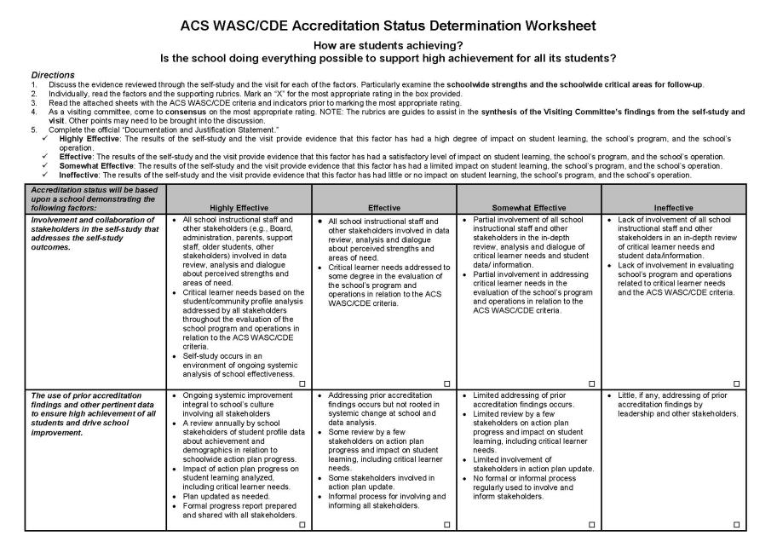
Status Worksheet — Take a quick look
ACS WASC ©2018-19
Notes:
Suggest schools prepare themselves with this document. Maybe before they start this whole process and as a final preparation for the visit.
Remind members there is a Doc and Just ON the new VC template

Slide 45
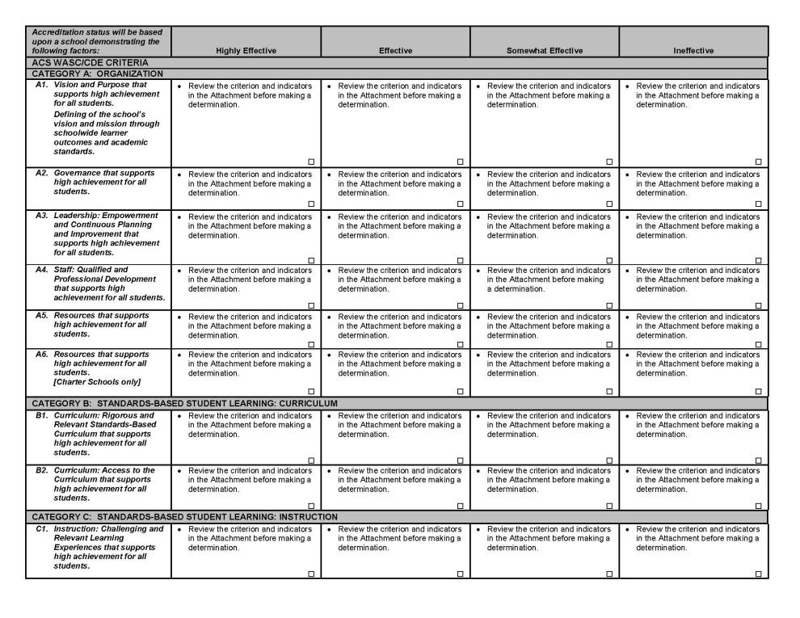
ACS WASC ©2018-19

Slide 46
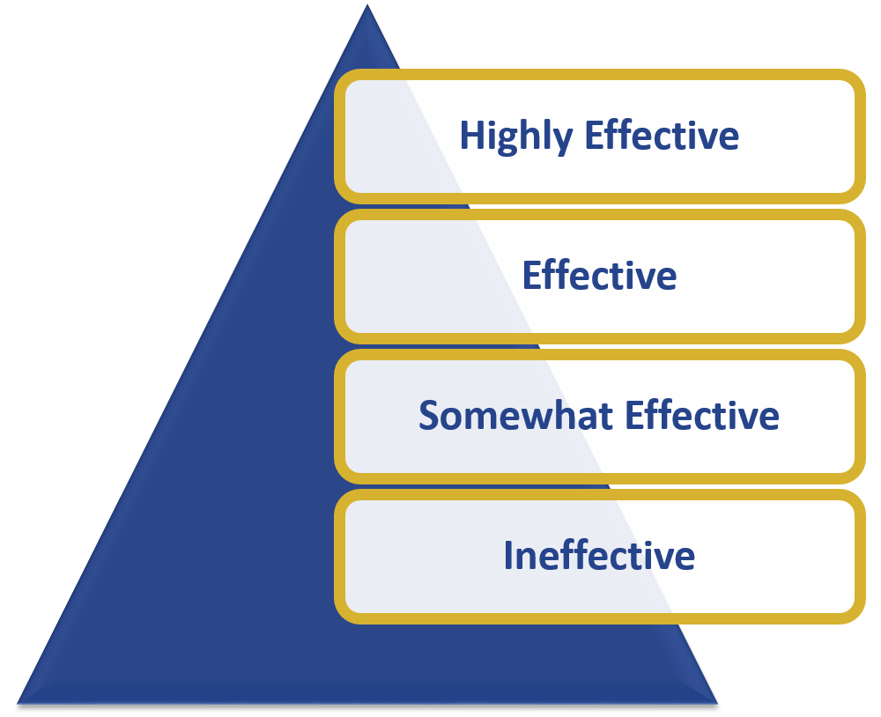
Accreditation Status Factors: VC Recommendation and Commission Action

Slide 47
Accreditation Status
Six-Year Accreditation Status
Progress report at mid-cycle
Progress report and one-day visit at mid-cycle
Progress report and two-day visit at mid-cycle
One-or-Two-Year Probationary Status with an in-depth progress report and a two-day visit
Accreditation Status Withheld

Slide 48
Accreditation Status Timeline

Slide 49
We Are Student Centered

Slide 51
Thank You
Need assistance? Have a question?
Need clarification?
Contact Information:
Marilyn George
mgeorge@acswasc.org

