Slide 1


ACS WASC Postsecondary Visiting Committee Final Presentation
Accrediting Commission for Schools
Western Association of Schools and Colleges
___________________ <Name of School>
___________________ <Date of Visit>

Slide 2
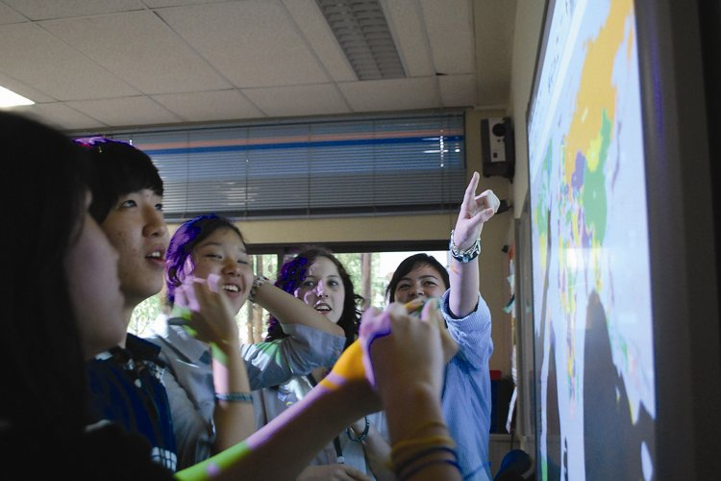


The ACS WASC accreditation process asks…
How do you know that all students are achieving based on our schoolwide student goals and academic standards?
Is the school doing everything possible to support high achievement for all its students?

Slide 3

Institutional Mission and Schoolwide Learner Outcomes
Areas to Celebrate
Text here (Use key phrases from VC Report)
…
…
…
Areas for Focus
Text here (Use key phrases from VC Report)
…
…
…

Slide 4
Organizational Infrastructure and School Leadership
Areas to Celebrate
Text here (Use key phrases from VC Report)
…
…
…
Areas for Focus
Text here (Use key phrases from VC Report)
…
…
…

Slide 5
Faculty and Staff
Areas to Celebrate
Text here (Use key phrases from VC Report)
…
…
…
Areas for Focus
Text here (Use key phrases from VC Report)
…
…
…

Slide 6
Curriculum
Areas to Celebrate
Text here (Use key phrases from VC Report)
…
…
…
Areas for Focus
Text here (Use key phrases from VC Report)
…
…
…

Slide 7
Instructional Program
Areas to Celebrate
Text here (Use key phrases from VC Report)
…
…
…
Areas for Focus
Text here (Use key phrases from VC Report)
…
…
…

Slide 8
Use of Assessment
Areas to Celebrate
Text here (Use key phrases from VC Report)
…
…
…
Areas for Focus
Text here (Use key phrases from VC Report)
…
…
…

Slide 9
Student Support Services
Areas to Celebrate
Text here (Use key phrases from VC Report)
…
…
…
Areas for Focus
Text here (Use key phrases from VC Report)
…
…
…

Slide 10
Resource Management
Areas to Celebrate
Text here (Use key phrases from VC Report)
…
…
…
Areas for Focus
Text here (Use key phrases from VC Report)
…
…
…

Slide 11
Community Connection
Areas to Celebrate
Text here (Use key phrases from VC Report)
…
…
…
Areas for Focus
Text here (Use key phrases from VC Report)
…
…
…

Slide 12
Action Plan for Continuing Improvement
Areas to Celebrate
Text here (Use key phrases from VC Report)
…
…
…
Areas for Focus
Text here (Use key phrases from VC Report)
…
…
…

Slide 13

Celebrate Schoolwide Strengths
Text here (Use key phrases from VC Report)
…
…
…

Slide 14
Critical Areas for Focus
Areas identified in the Self-Study that you should continue to focus on:
Areas for Focus
Text here (Use key phrases from VC Report)
…
…
…
As you plan and implement your work, include
  Text here (Use key phrases from VC Report)
…
…
…

Slide 15

Making It Happen: Ongoing Work
Text here (e.g., use of data, professional dialogue about student work and learning)
…
…
…

